Slide 1


TravelTide
Customer Insights Project
“Enhancing customer retention and engagement”
By Sanchita Neupane
18 April 2024

Slide 2
Agendas
Introduction
Project Objectives
Business Questions
Customer Segmentation Approaches
Metrics Used in the Analysis
Demographic Analysis
Perks Allocation
Recommendations
Conclusions

Slide 3
Introduction
The overview of TravelTide is emergence in the online travel industry, supported by positive customer feedback and industry analysts.
TravelTide focus on exceptional service and staying up-to-date with emerging trends.

Slide 4
Project Objectives
Aim to design personalized rewards based on customer behavior and preferences.
Enhance customer retention and engagement through personalized rewards.
Identify must appealing perks for individual customers based on their behavior and preference.

Slide 5
Methodology
Data Extraction and Exploration
SQL

Slide 6
Methodology
Data Extraction and Exploration
SQL
Data Visualization
Tableau

Slide 7
Business Questions
What are the behavior and preferences of different customer groups?

Slide 8
Business Questions
What are the behavior and preferences of different customer groups?
How can these be used to generate customized promotions?

Slide 9
Business Questions
What are the behavior and preferences of different customer groups?
How can these be used to generate customized promotions?
Which perks are suitable for each group to increase company revenue?

Slide 10
Customer Segmentation Approaches
Free Hotel Meal: Target customers are people interested in discount.
Free Checked Bags: Target customers are customers with many bags i.e family.
No Cancellation Fee: Target customer are who frequently cancel trips.
Exclusive Discount: Target customer are who are active discount seeker.
Free Hotel with Flight: Target customers are who book both flights and hotels together without considering discount

Slide 11
Metrics used in the Analysis
Session Intensity Index
Hotel Hunter Index
Bargain Hunter Index

Slide 12
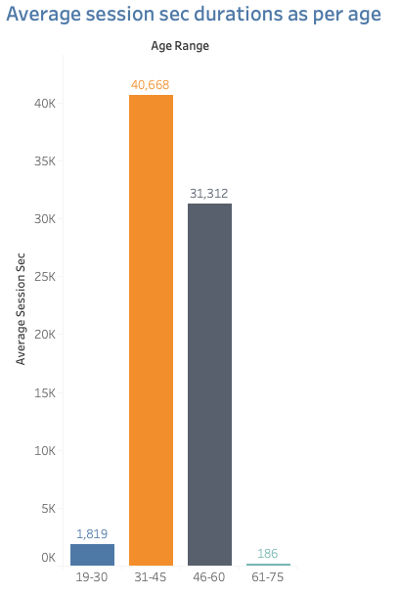
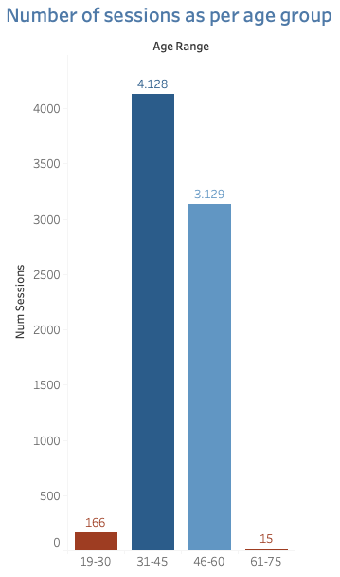
Demographic Analysis
Session Intensity Index
Age group 31-60 are the most active users of the TravelTide app.

Slide 13
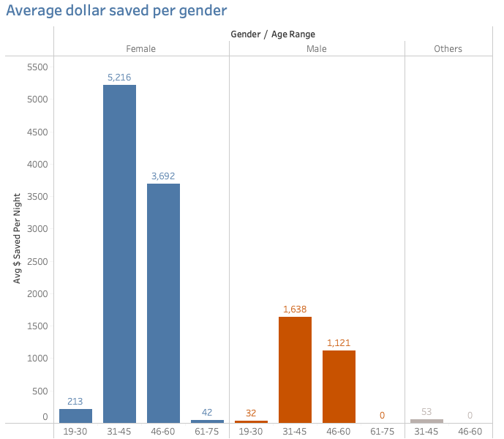
Hotel Hunter Index
Female users in the 31-60 age range focused on saving money on hotel bookings.

Slide 14
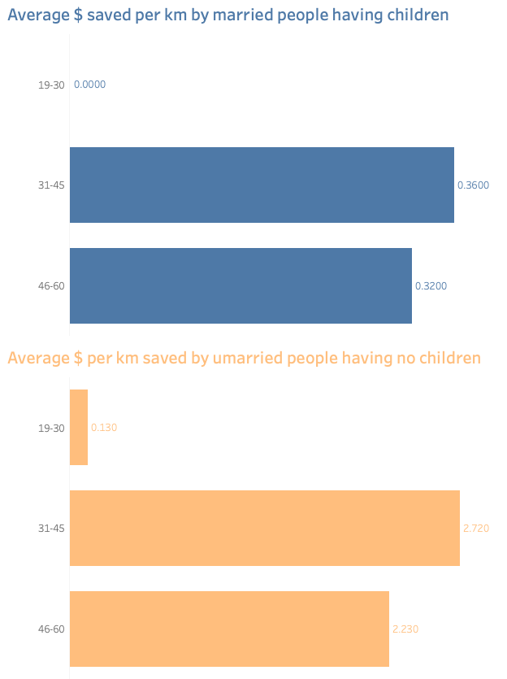
Bargain Hotel Hunter Index
Single individuals without children are interested in flight discounts, frequently hunting for the best prices.

Slide 15
Perks Allocation
Free Hotel Meal appeals to customers looking for hotel discounts.
Free Checked Bags attracts travellers with children or multiple bags.
No Cancellation Fee targets frequent trip cancellers.
Exclusive Discount: Draws active flight discount seekers.
Free Hotel Night with Flight attracts loyal customers who book flights and hotels together.

Slide 16
Recommendations
Offer tailored perks based on customer preferences.
Customize marketing campaign.
Monitor program performance and adjust as needed.
From this analysis I found out that the age group from 30-60 are the most active customers and they are to be retained in order to increase the revenue of the company.

Slide 17
Conclusions
Summary of how the recommendations can create a more personalized experience.
Expected outcomes: Higher retention rates and increased.

Slide 18
Thank You!

